Slide 1
Chapter 8
Structure and Union
Er. Amrit Poudel

Slide 2
Contents
Introduction to structure
Arrays of structure
Nested structure
Pointer to structure
Self-referential structure
Unions
Structure Vs Union
Array Vs Structure
Passing structures to function
Menu driven structure

Slide 3
8.1 Structure
Suppose, we need to store records of student which consists of student name, address, roll no and age.
At this time, we cannot use array, but we need to define a structure to hold this information.
struct keyword is used to define a structure. struct defines a new datatype which is collection of different types of data.

Slide 4
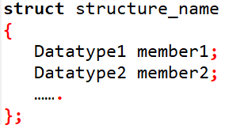
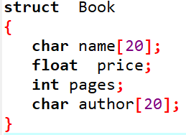
How to define a structure ?
Syntax:
Eg:

Slide 5
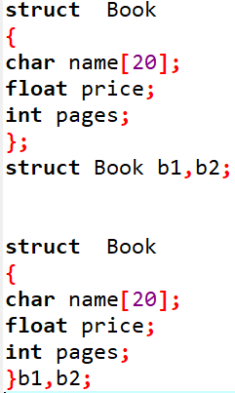
How to declare a structure variable?
Declaring structure variables separately:
Declaring variables with structure definition:

Slide 6
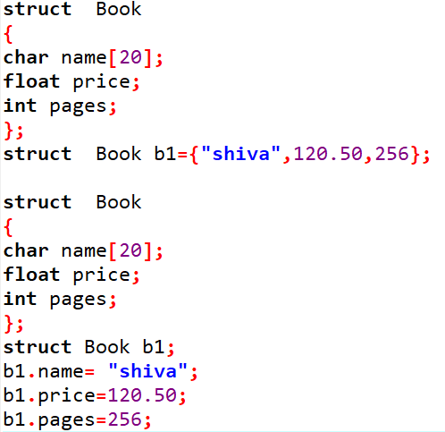
Structure Initialization
At compile time, structure initialization can be done as:
or

Slide 7
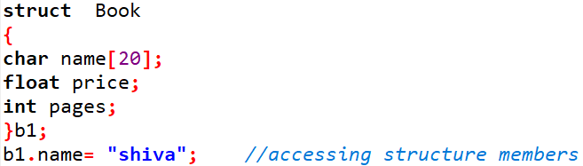
Accessing Structure members
Dot(.) operator used to access members of structure.
Syntax:
Structure_variable . member ;

Slide 8
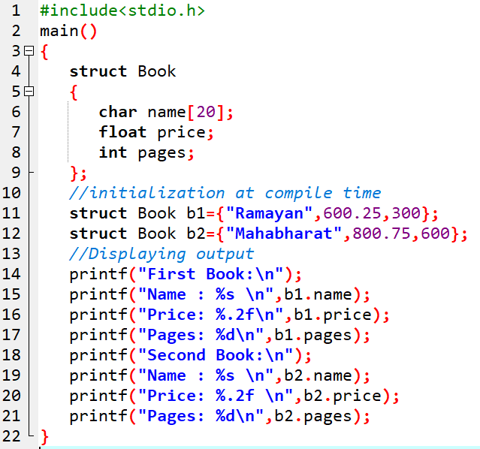
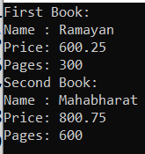
Prog 1: WAP to create a structure Book (members: Name, price and pages) that is initialized at compile time for two books. Also display them.

Slide 9
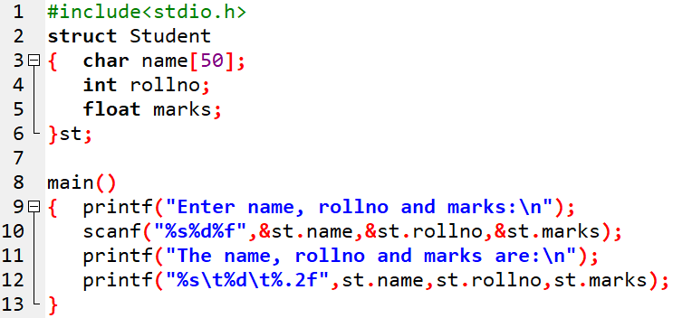
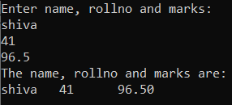
Prog 2: WAP to declare a structure Student (members : name, rollno and marks). The program should ask the input and then display them.

Slide 10
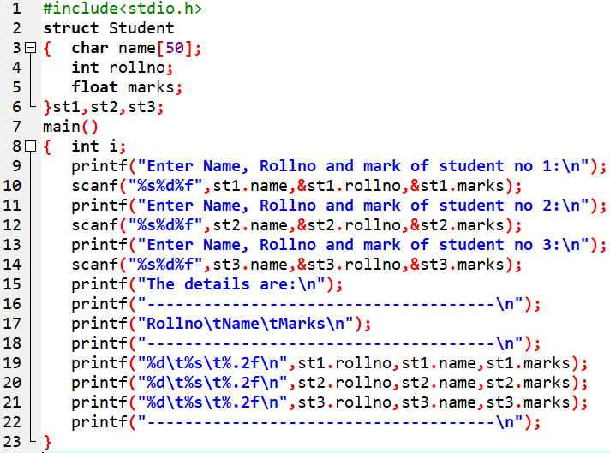
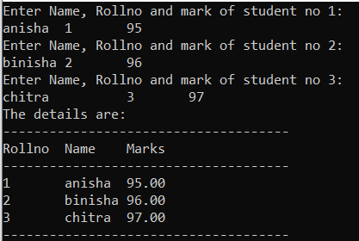
Prog 3: WAP to declare a structure student with its members name, rollno and marks. The program should ask the input for three students and display them.

Slide 11
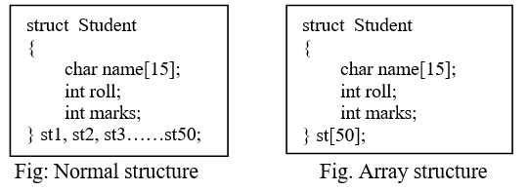
8.2 Array of structure
If we need to make more structure variables, we can make array of structure in the same pattern as of array.
Here, st[50] is an array of structure.

Slide 12
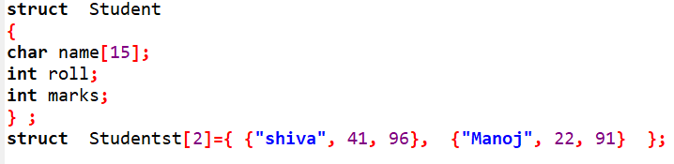
Initialization of Array of structure
Compile time initialization of array of structure.

Slide 13
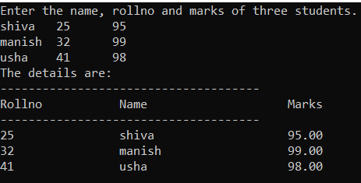
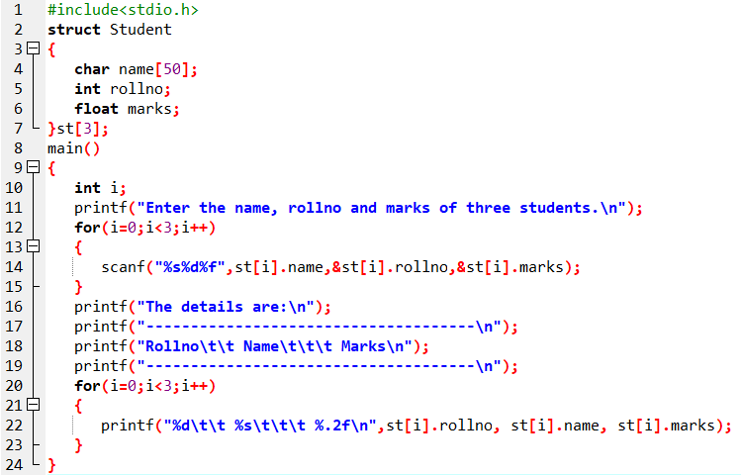
Prog 4: WAP to declare a structure Student with its members: name, rollno and marks. Using array of structure, the program should ask the input and display the information for three students.

Slide 14
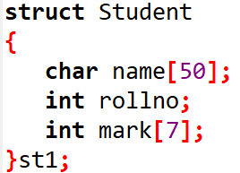
Array within structure
Here, the member mark is an array of 7 elements mark[0], mark[1], mark[2],……. mark[6].
These are accessed like:
st1.mark[0];
st1.mark[1];
…….
st1.mark[6];

Slide 15
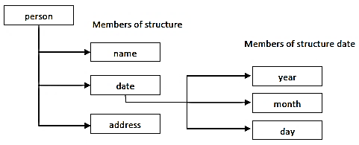
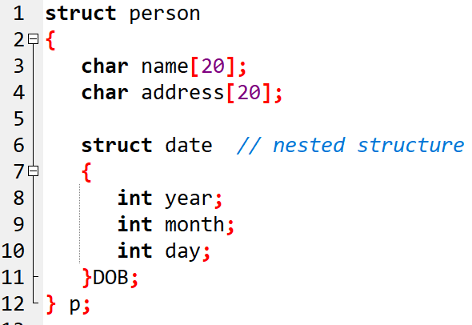
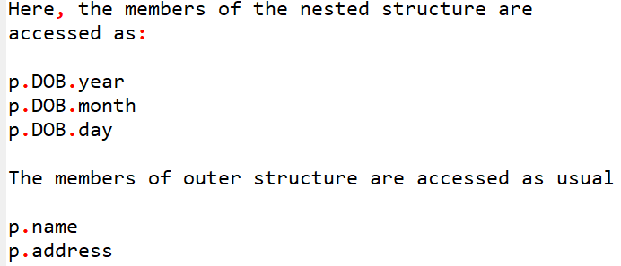
8.3 Nested structure
If a structure is inside an outer structure, then the inside structure is called a nested structure.
The outer structure is called nesting structure.

Slide 16
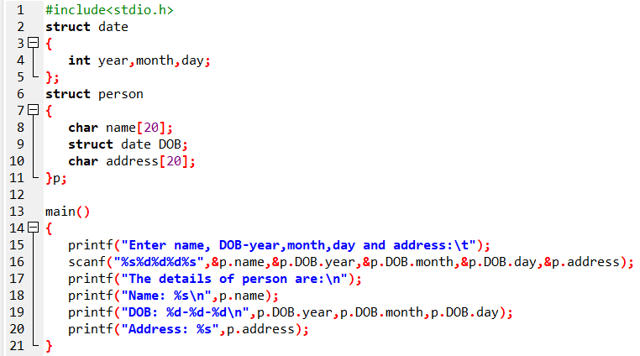
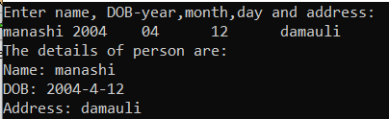
Prog 6: WAP to create a structure date (members year, month, date) inside a structure person (members name, date and address), and also to accept name, date of birth (year, month and day) and address. Also the program should display all these information.

Slide 17
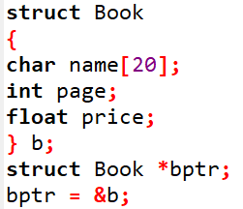


8.4 Pointer to structure
Pointer can be used with structure to store address of the structure type variable.
Example: To access members:
or

Slide 18
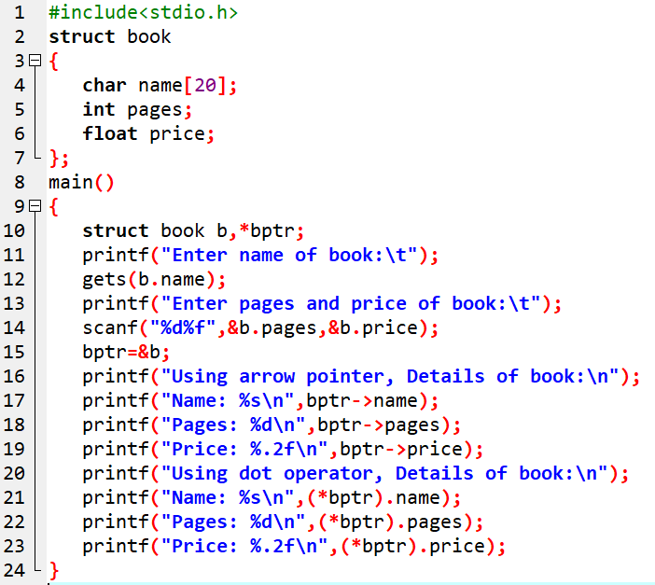
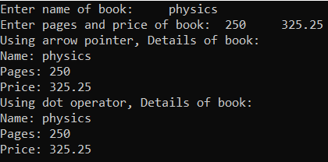
Prog 7: WAP to create a structure book (members: name, pages and price) and that accepts the name, page and price of a book using structure variable. Finally display the record of book using pointer to structure.

Slide 19
8.5 Self-referential structures
A structure which has at least one member of type pointer to the same structure is known as self-referential structure.
Consider:
struct List
{
int data;
struct List *next;
};
Here, List is a structure which has two members:
data of type int
next which is pointer of parent type structure(List).

Slide 20
8.6 Unions
Similar to structure, a union is also a collection of different datatypes under a single name.
The difference with structure is that: all the members within a union share the same storage area of memory.
Thus union conserves less memory space.
Keyword used: union

Slide 21
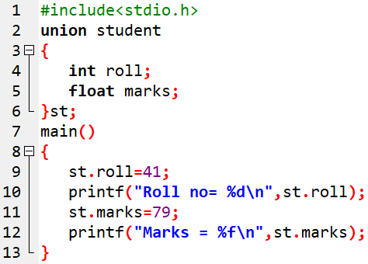
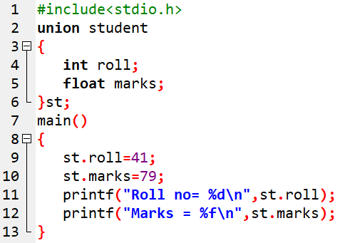


Example:

Slide 22
8.9 Passing structures to functions
cases to deal with:
Passing structure members to functions
Passing entire structure to a function
Passing structure pointer to a function
Passing an array of structure to a function

Slide 23
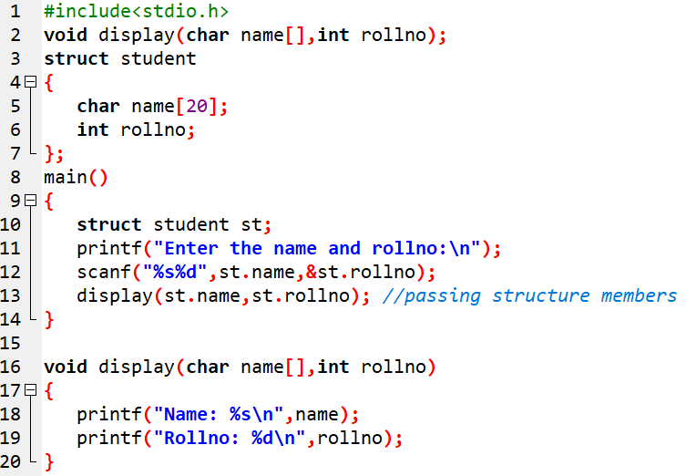

i) Passing structure members to functions
Individual structure members can be passed to a function as arguments like ordinary variables.

Slide 24
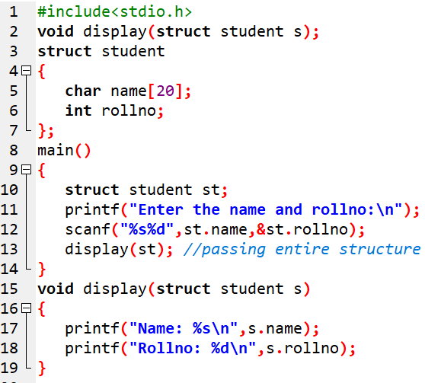
ii) Passing entire structure to function
For this we simply write the structure variable in the argument of calling statement, i.e display(st),

Slide 25
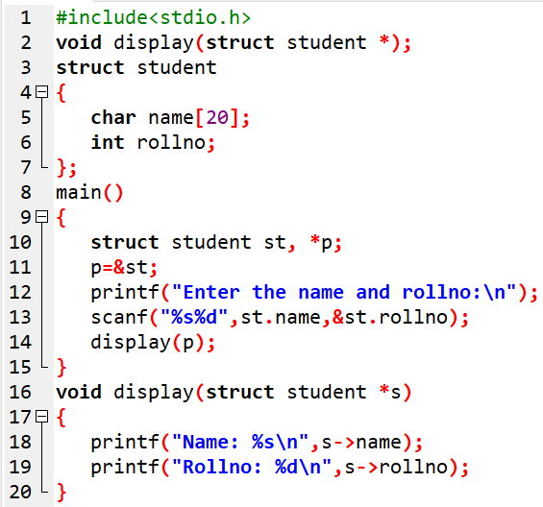
iii) Passing structure pointer to function
While passing structure pointer to a function, the function is called by reference.
Any changes that are made within the function are also visible in the calling function.

Slide 26
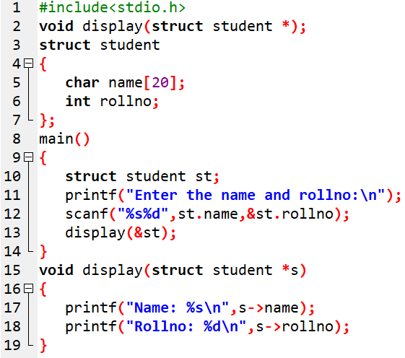

Slide 27
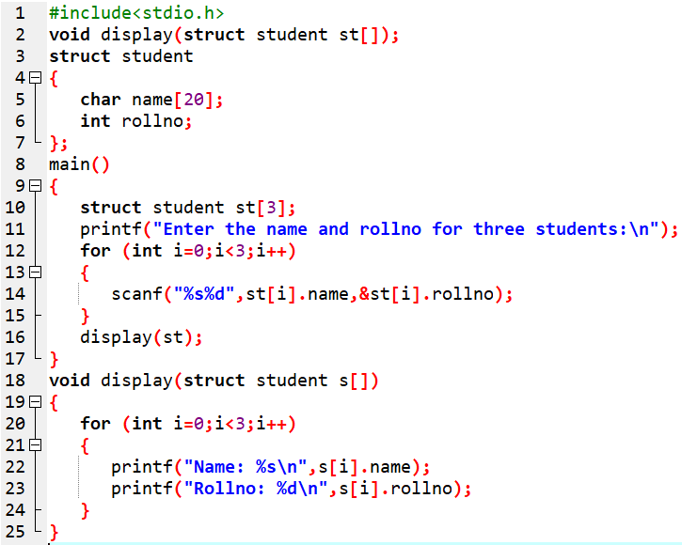
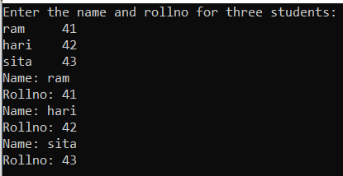
iv) Passing an array of structure to function
Passing an array of structure to a function involves the same syntax and characteristics as passing an array of an ordinary type of function.

Slide 28
8.10 Menu Driven Structure
The switch statement can be used for menu driven program.
Sample program:
An employee record consists of its ID, name, age, salary and address. Write a Menu driven program to perform following operations:
Read the records of 3 employees
Display the records of all employees
Display the records of all the employees whose salary is greater than 10000 and age greater than 25 years.
Display the records of employees from only “Pokhara”.
Exiting program

Slide 29
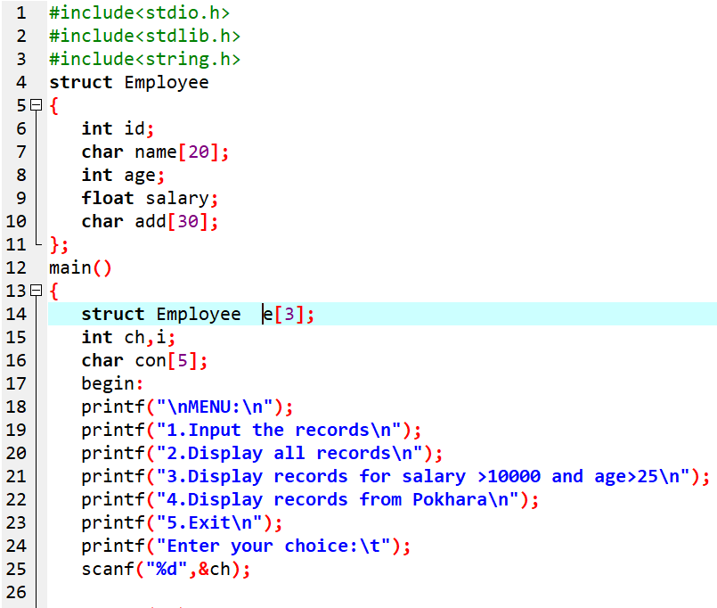

Slide 30
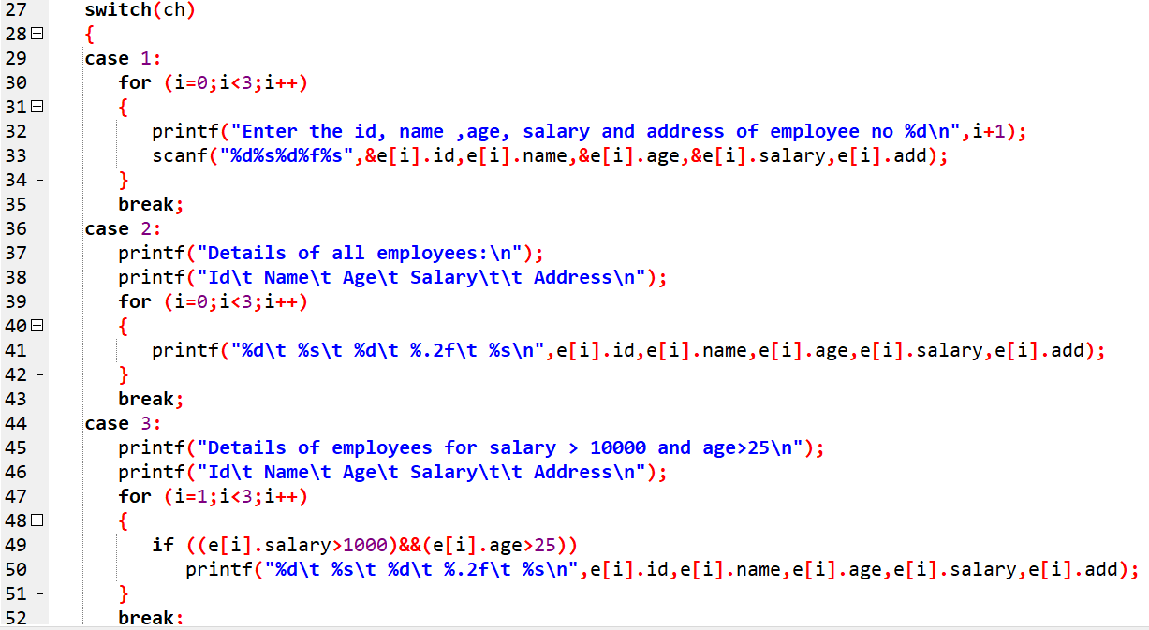

Slide 31
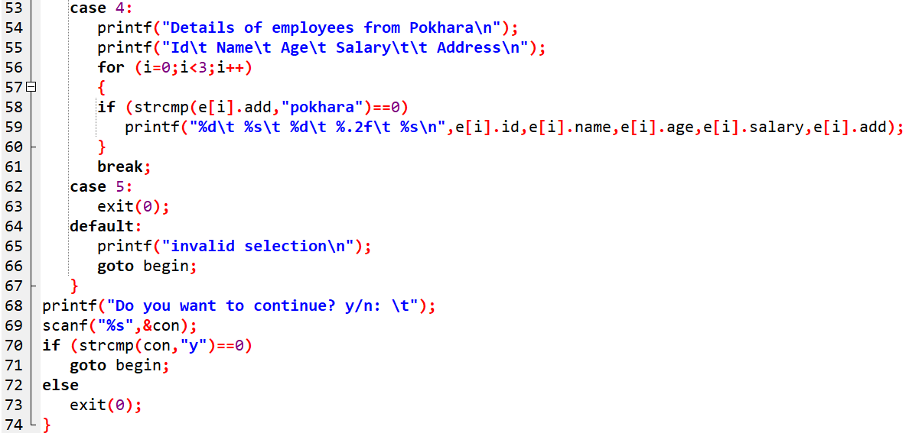

Slide 32
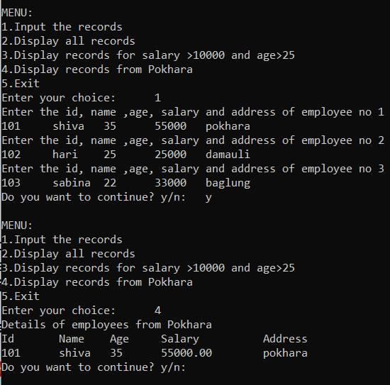

Slide 33
Assignment:
WAP to store and print name, address, department and marks using a pointer to structure.
WAP to read name, address and salary of 5 staffs using array of structure. Display the information of each employee in ascending order of their name.
Create a structure called Book having member name, price, author and published date in day, month and year. Now WAP to read 100 books information from the user and display the information of those books having price greater than Rs.250.
WAP to read name, address and salary of 5 staffs using array of structure. Display the information of each employee in ascending order of their name.
Create a structure Date (members: day, month, year) nested in the structure Book (members: name, price, author). Now WAP to read 3 books information from the user and display the information of those books having price greater than Rs.250.
WAP to read name, pages and price of 3 books using array of structure and display the information of the book whose price are higher than 1000
WAP to read name, pages and price of 5 books using array of structure and display the information of:
The most expensive book.
The third most expensive book.
The most cheapest book.
An employee record consists of its ID, name , age, salary, address. Write a Menu driven program using structure to perform following operations:
Read the records of 10 employees
Display the records of all employees in ascending order of their ID.
Display the records of all the employees whose salary is in between 10000 and 50000.
Display all the records whose name begins from “s”.
Exiting the program.

Slide 34
End of Chapter

